Slide 1
SDNFV FINAL PROJECT
SDN Network as Virtual Router
助教：蔣汶儒
sdnta@win.cs.nycu.edu.tw
Deadline: 2024/12/19

Slide 2
OUTLINE
Review of Labs
Virtual Router Explained
Virtual Router Specification
ONOS App and Services in Use
In Used App Configurations
Virtual Router Workflow
Project Information and Installation
Supplement
Scoring Criteria
Reference

Slide 3
OUTLINE
Review of Labs
Virtual Router Explained
Virtual Router Specification
ONOS App and Services in Use
In Used App Configurations
Virtual Router Workflow
Project Information and Installation
Supplement
Scoring Criteria
Reference

Slide 4
Review of Labs
Lab2
ONOS API
Flow rules
Lab3
Mac learning
Proxy ARP
Lab4
Intent
Meter Table
Lab5 Network Function Virtualization
Simulate Autonomous Systems (AS)

Slide 5
OUTLINE
Review of Labs
Virtual Router Explained
Virtual Router Specification
ONOS App and Services in Use
In Used App Configurations
Virtual Router Workflow
Project Information and Installation
Supplement
Scoring Criteria
Reference

Slide 6



SDN-enabled Virtual Router
SDN Network with virtual router
Use openflow switches and flowrules to simulate router behavior
For instance:
Layer2 forwarding for next hop communication
Boarder gateway route exchange
Etc.
AS 65001
SDN Network
AS 65000
AS 65002

Slide 7


Traffic Types
Intra-domain Traffics
Where hosts within the same AS communicates with each other.
SDN handles the traffic.
AS 65001
SDN Network
AS 65000
AS 65002

Slide 8

Traffic Types (cont.)
Inter-domain Traffics
Where an external host from other domain communicates with an internal host.
The traffic pass through gateways.
Virtual router needs to do something.
AS 65001
SDN Network
AS 65000
AS 65002

Slide 9

Traffic Types (cont.)
Transit Traffics
Where hosts from different domains communicates with one another bypass the SDN network.
The traffic pass through virtual router.
Virtual router needs to do something.
AS 65001
SDN Network
AS 65000
AS 65002

Slide 10
Networks with Physical Routers
Physical routers
1. Deal with routing decision.
2. Deal with gateway exchange.
Every edge requires a router, running eBGP and iBGP protocols.
AS 65001
AS 65000
Switch
Switch
AS 65002
AS 65003

Slide 11

SDN Networks with Virtual Routers
SDN-enabled Virtual Routers
Doesn’t requires router connection to edge.
Only one BGP speaker is enough.
Doesn’t need a real gateway.
AS 65001
AS 65000
BGP Speaker
(FRRouting)
OVS1
OVS2
AS 65002
AS 65003

Slide 12
OUTLINE
Review of Labs
Virtual Router Explained
Virtual Router Specification
ONOS App and Services in Use
In Used App Configurations
Virtual Router Workflow
Project Information and Installation
Supplement
Scoring Criteria
Reference

Slide 13
Goal
Intra-domain host communication
Handled by Bridge APP
Inter-domain host communication
SDN domain <-> Other domain
Transit host communication
Other domain <-> SDN domain <-> Other domain

Slide 14
vRouter Specification
Intra AS packet forwarding and packet-in request
Lab3
Arp Reply for devices in AS
Lab3
Inter-domain eBGP traffic topology
Lab5
Routing table maintenance
Lab5
Flowrules for intra/inter/transit domain traffic
vRouter APP
IPv4 and IPv6 Dual stack
With Additional IPV6 Capability !!!!

Slide 15
OUTLINE
Review of Labs
Virtual Router Explained
Virtual Router Specification
ONOS App and Services in Use
In Used App Configurations
Virtual Router Workflow
Project Information and Installation
Supplement
Scoring Criteria
Reference

Slide 16
ARP in IPv6
ARP are only for IPv4s, how does IPv6 know the MAC address of the target?
Neighbor Discovery Protocol (NDP)
ICMPv6 Messages
Neighbor Solicitation (Type 135)
Similar to ARP request
Neighbor Advertisement (Type 136)
Similar to ARP response
Type
Code
Checksum
Content
ICMPv6 Packet

Slide 17
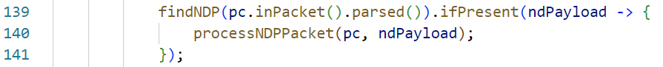
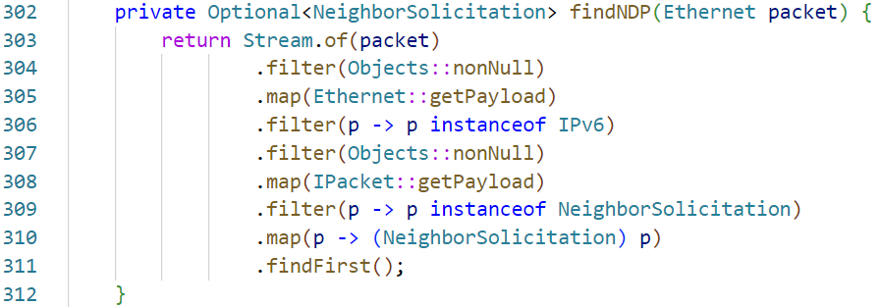
ARP App Extension for IPv6
Handle certain packets
Example code to determine neighbor solicitation packet type
Simple way to build a neighbor advertisement packet

Slide 18
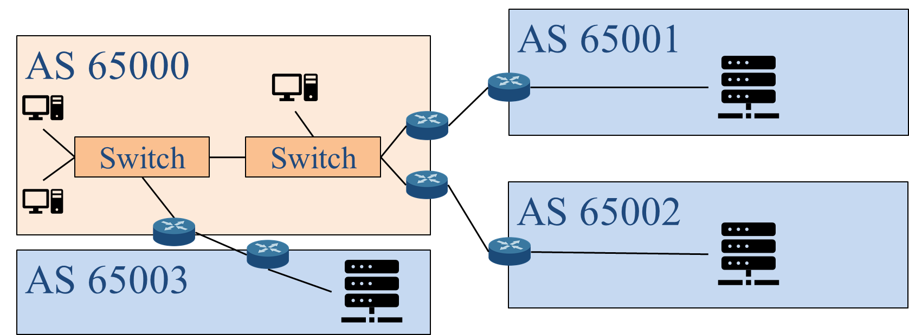
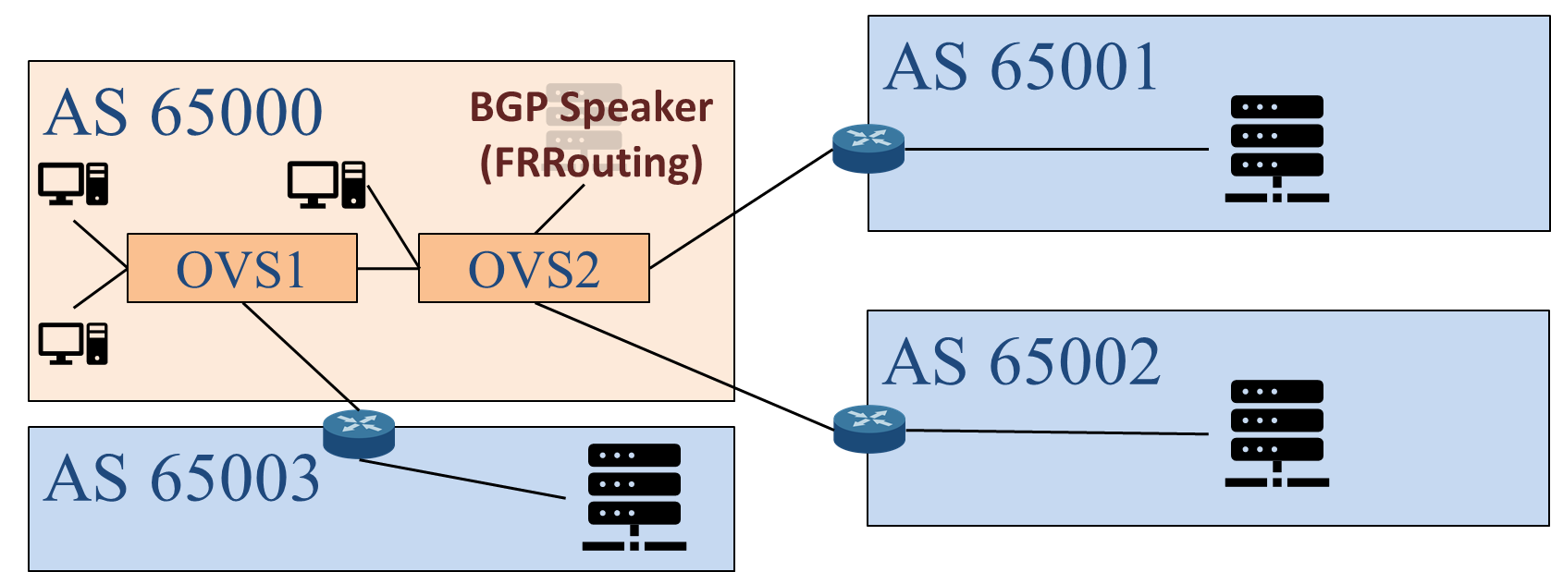
Virtual Router BGP Connection
Physical router:
External routers connect with the boarder gateway.
Virtual router:
External routers connect with BGP Speaker.
Need to delegate BGP Speaker IP to edge switch.

Slide 19
BGP Speaker IP Delegation and Routing
Delegate BGP speaker IP to the WAN Connect Point on edge switch.
Determine WAN Connect Point.
Config (via netcfg) WAN Connect Point interface.
Route packet between BGP speaker Connect Point and WAN Connect Point.
Determine BGP speaker connect point.
Install rule to route packets.

Slide 20
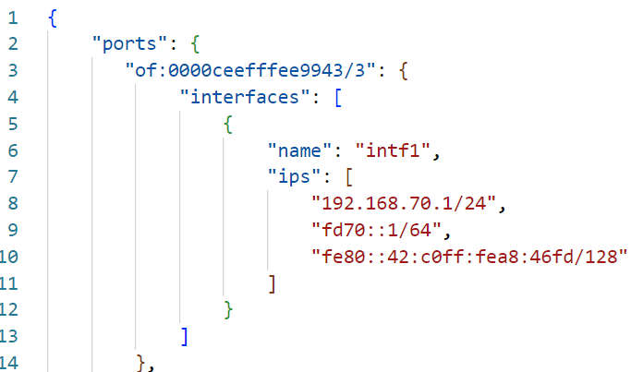
WAN Connect Point Configuration
Create a configuration file for WAN Connect Point
Making external routers think that the BGP Speaker is at the Connect Point.
Connect Point
Interface Config
*NOTE
This only gives ONOS controller information of the interface and its IPs. How to make BGP speaker receive packets designated to the IP is your work!

Slide 21
WAN Connect Point Information Retrieval
Use ONOS Interface Service to retrieve WAN Connect Point.
Import Interface service
Reference interface service
Query WAN Connect Point information from the interface service

Slide 22
Zebra FIB Pushing
Zebra supports a Forwarding Information Base (FIB) Push Interface (FPI)
FPI allows an external component to learn the forwarding information.
Forwarding Plane Manager (FPM)
Receives FIB
Decode FIB into routes
FIB pushing:
FPM establishes a TCP connection with Zebra
Zebra pushes FIB to FPM
In this project, we use ONOS built-in FPM to collect FIB from zebra.

Slide 23
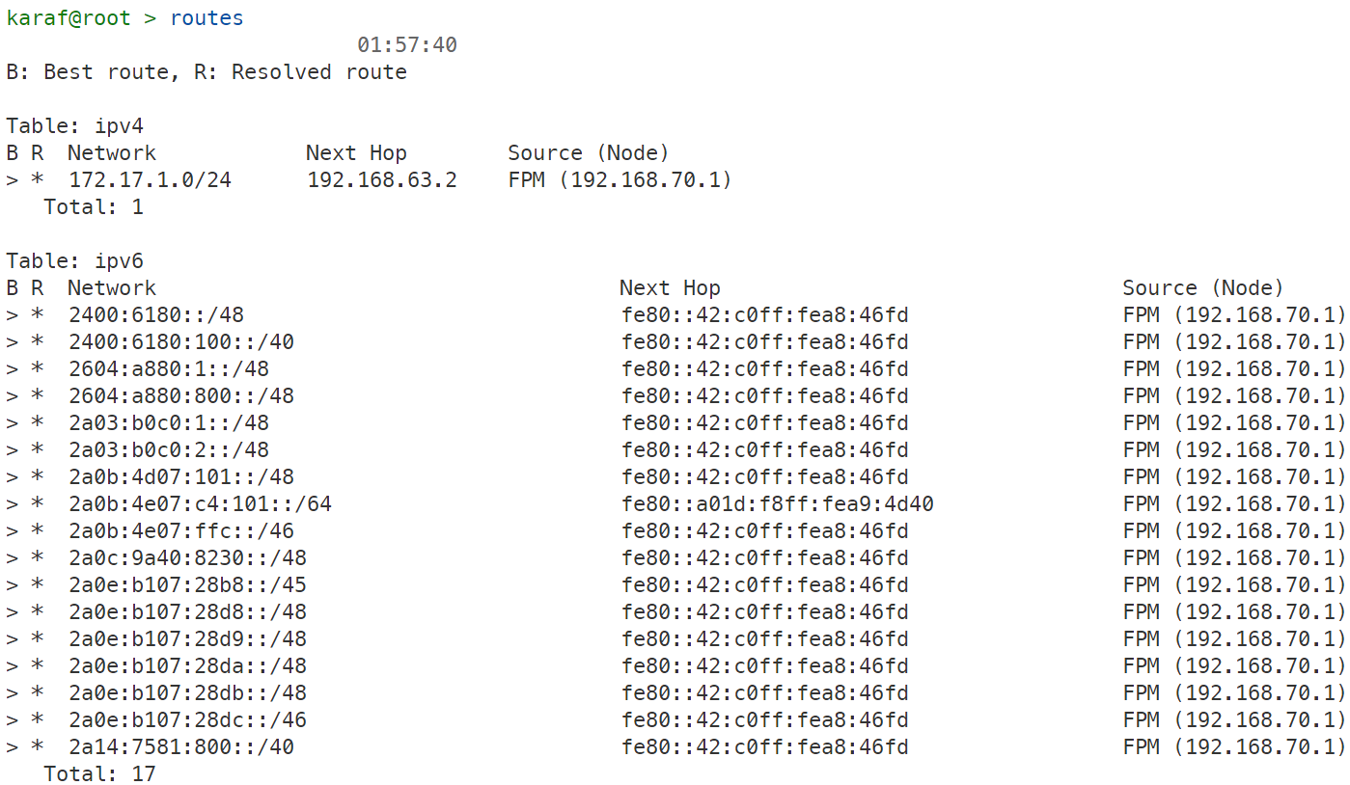
BGP Route Retrieval with Route Service
Route Service will collect route information via FPM APP.
Routes provided by Route Service contains next hop info for target subnet.
Route Service provide routing table query API.

Slide 24
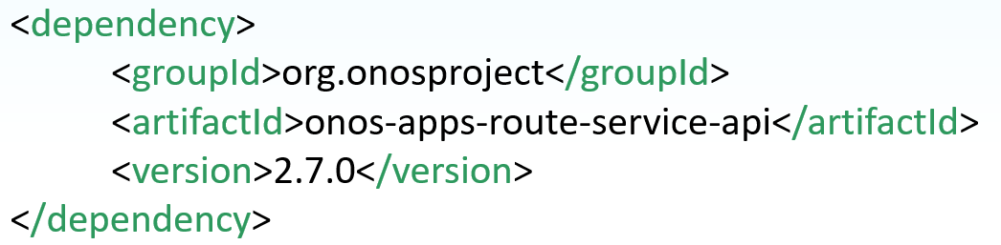
ONOS Route Service Usage
Update dependencies in pom.xml file.
Import methods.
Read the docs
https://javadoc.io/doc/org.onosproject/onos-cli/1.8.1/org/onosproject/incubator/net/routing/package-summary.html

Slide 25
OUTLINE
Review of Labs
Virtual Router Explained
Virtual Router Specification
ONOS App and Services in Use
Zebra and FRRouting Configurations
Virtual Router Workflow
Project Information and Installation
Supplement
Scoring Criteria
Reference

Slide 26
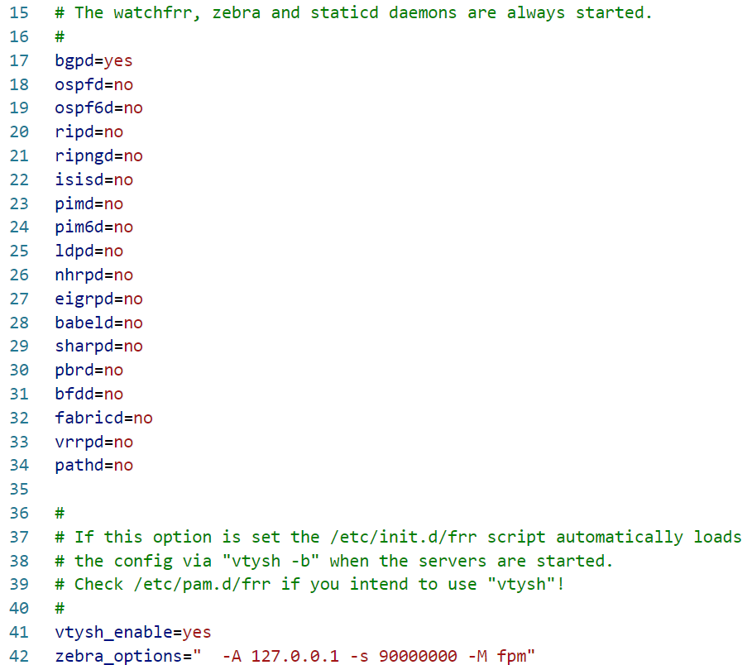
Enabling FPM Module
To enable FPM, you have to set –M fpm in zebra_options at /etc/frr/daemons

Slide 27
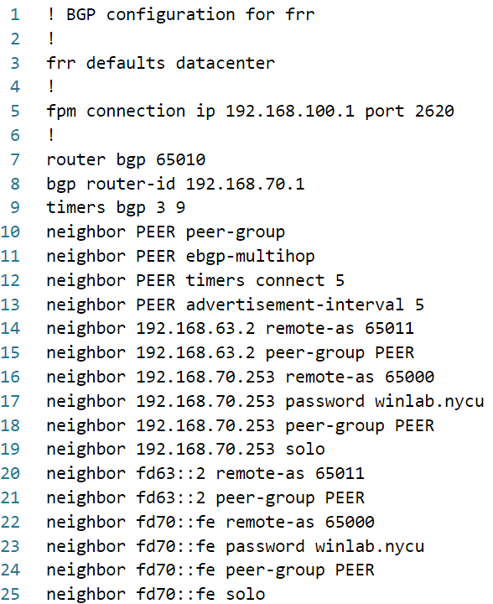
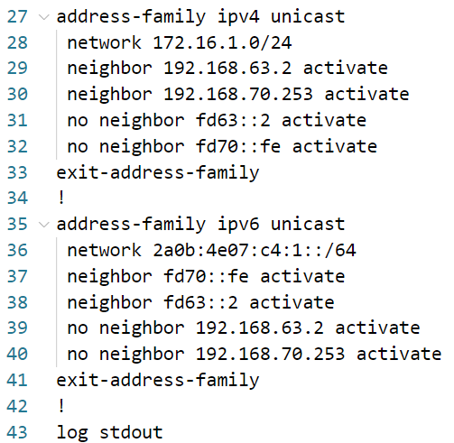
FRRouting Configuration
Configurations in /etc/frr/frr.conf
FPM connection
Announce IPv4 prefix on IPv4 Interface
Peer Group (template) for neighbors
Use the template
BGP Passwords
Don’t advertise the prefix that you received
Same as IPv6 Interface
NOTE* Older versions of FRRouting might not work, this is just an example

Slide 28
OUTLINE
Review of Labs
Virtual Router Explained
Virtual Router Specification
ONOS App and Services in Use
In Used App Configurations
Virtual Router Workflow
Project Information and Installation
Supplement
Scoring Criteria
Reference

Slide 29
BGP Message Exchange
In order to exchange BGP message with neighbor router
Neighbor discovery for L2 connectivity
Proxy ARP APP handles ARPs and NDPs on behalf of BGP Speaker.
L3 forwarding for BGP Messages
L3 forwarding for BGP Messages?
Incoming
Hint: MultiPointToSinglePoint intent
Outgoing
????

Slide 30
Virtual Gateway and Inter-domain Routing
Gateway and Routing
Assume Gateway IP: 192.168.1.254/24
Packets originated from 192.168.1.0/24 towards other networks
Packet first sent to Gateway.
Packet coming from other networks destined 192.168.1.0/24
Packet first received by Gateway.
IP is the logical address of ultimate destination.
But, MAC is the physical address of the next hop.

Slide 31
Gateway Traffic Handling Example
Any packets within the domain only knows about the gateway’s MAC.
After analyzing the information (IP), it will change the according MAC and sends the packet out.
DOMAIN A
DOMAIN B
src
dst
src
dst
src
dst
IP
A
B
A
B
A
B
MAC
A
R1
R1
R2
R2
B
Host A
Host B
R1
R2

Slide 32
Transit Traffics
Transit traffics are in fact two interdomain traffics.
DOMAIN B
src
dst
A
C
Host B
R1
R2
R1
DOMAIN A
DOMAIN C
R2
src
dst
Host C
A
C
R4
R2
R4

Slide 33
OUTLINE
Review of Labs
Virtual Router Explained
Virtual Router Specification
ONOS App and Services in Use
In Used App Configurations
Virtual Router Workflow
Project Information and Installation
Supplement
Scoring Criteria
Reference

Slide 34
Linux Network Brief Introduction
Network Namespaces
Provide a way to create isolated network environments within a Linux system.
Allow processes to have their own network stack, including interfaces, routing tables, and firewall rules.
Each Container have it’s own Network Namespace.
A network Bridge is a kernel created logical L2 switch
Veth devices, short for virtual Ethernet devices
Use veth pairs to connect Network Namespaces or Bridges together.

Slide 35
Linux Network Brief Introduction (cont.)
Mapping to physical instruments.
Namespace = node (computer/server)
Veth pair = 2 network interface cards (NIC) that connects to each other
Bridge = switch
If you want to connect your computer to a switch
Create a veth pair (Create 2 NIC that connects to each other)
Connect one NIC to your namespace
Connect the other one to your bridge
Bridge
Namespace
Veth
Veth

Slide 36
Linux Network Brief Introduction (cont.)
Mapping to physical instruments.
Namespace = node (computer/server)
Veth pair = 2 network interface cards (NIC) that connects to each other
Bridge = switch
How to find a container’s namespace (ns)?
Locate docker pid
It is at file `/proc/$pid/ns/net`
Similarly you can connect two namespaces (containers) with the same mechanism.
Container
Container
Veth
Veth

Slide 37
Ubuntu IP Command Introduction
Normally, we can use `ip netns exec` command to execute commands inside a namespace; however, it will only search ns for directories in `/var/run/netns`
Two ways to run `ip netns exec` in container namespace
Create a soft link `ln -sfT /proc/$pid/ns/net /var/run/netns/$pid`
Use nsenter command `nsenter -t $pid -n <command>`
Useful ip commands
`ip link add <name> type <type>`: Create a NIC by the type.
`ip link set <name> up`: Bring up (enable) the NIC.
`ip address add <ip> dev <name>`: Add an ip address to the NIC.
`ip route show`: Show current routes.
`ip route add {<ip> | default} via {ip}: Add a route.

Slide 38
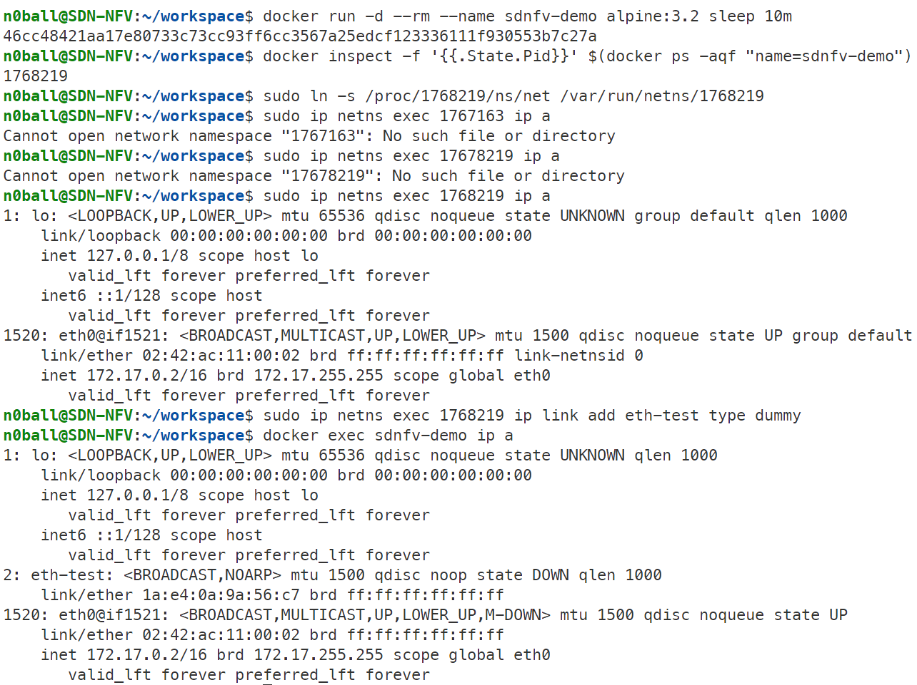
Docker Network Namespace Introduction
Create a container named sdnfv-demo
Find the pid of the container
Make soft link so that ip netns can find container ns
Show interface information of ns
Create a dummy NIC using netns command
Show interface information of the container
NIC is created inside the container

Slide 39
Tunnel and VXLAN
A Tunnel send data over a network by encapsulating packets within other packets.
Commonly used to connect different networks, provide secure communication, bypass firewalls.
Applications
Virtual Private Networks (VPN)
Generic Routing Encapsulation (GRE)
Virtual Extensible LAN (VXLAN)
Types
Layer 2: Transmit data that is higher or equal to Layer 2
Layer 3: Transmit data that is higher or equal to Layer 3
VXLAN (L2 Tunnel)
Designed to help build large, scalable L2 networks over existing L3 networks

Slide 40
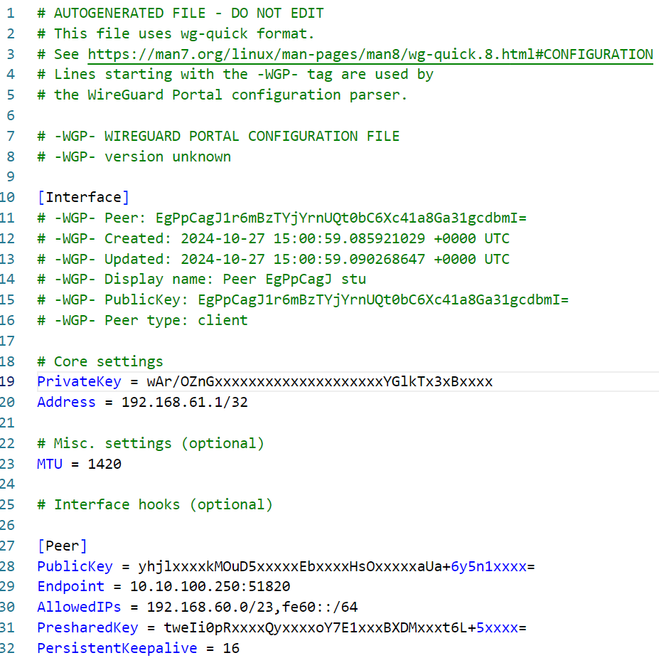
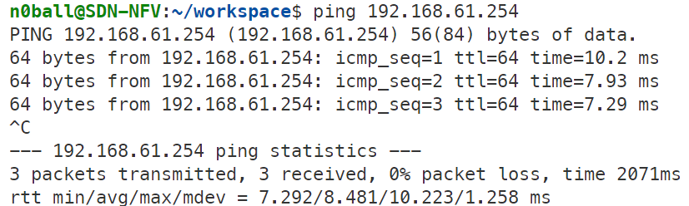
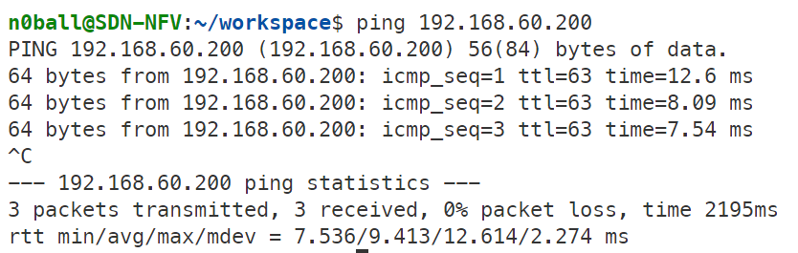
Wireguard
TA will provide a Wireguard configuration file
Remember, the last number of your IP is your ID (x)
Run the follow command to install wireguard
Copy the configuration file to wg0
Bring up the Wireguard interface
Check if Wireguard is good
Wireguard gateway
VXLAN Target
This is your ID (x)
This is Wireguard gateway
Some wireguard version requires port
This is your x

Slide 41
Maximum Transmission Unit (MTU)
The largest size (in bytes) of a network packet that can be transmitted over a particular interface or network medium without fragmentation.
Default to 1500 Bytes.
What Happens if Packet Size Exceeds the MTU?
Fragmentation
Drop (Especially IPv6)
Suggested subtraction of MTU due to encapsulation
VXLAN: 50 Bytes
Wireguard: 80 Bytes

Slide 42

Autonomous System (AS)
AS Types
Stub
Multi Homed
Transit
Internet Exchange Point

Slide 43
ISP Characteristic
Internet Service Provider (ISP)
A company or organization that provides individuals, enterprises, and other entities access to the internet.
Key Concepts
Internet Access
Internet Service
IP Addresses
If you have been assigned an IP from NYCU
How does the Internet world routes packets to your IP’s location?
How does others know the way to find you in the Internet world?
Goal: A vrouter in a small ISP and that manages internet resources.

Slide 44
ISP Service Requirements
Service requirements for customers.
Routers to exchange other AS’s route.
Layer 2 modification
Packet handling
Service requirements for other ISPs.
Packet handling
Quality of Service (QoS)

Slide 45
Topology
Student x
TA
1Gbps Rate Limit
AS65xx0 (SDN Network)
AS65xx1
FRRouting
ONOS
Host 2
Host 1
VXLAN
VXLAN
AS65000
Student y
1Gbps Rate Limit
ONOS
AS65yy1
Host 1
FRRouting
VXLAN
Host 2
AS65yy0 (SDN Network)

Slide 46
Topology for 3 Students
AS65xx0 (SDN Network)
VXLAN
VXLAN
AS65yy0 (SDN Network)
AS65zz0 (SDN Network)
VXLAN

Slide 47
Configuration Requirements
You are running an AS65xx0 and announcing prefixes
172.16.x.0/24.
2a0b:4e07:c4:xx::/64
You help to transit prefixes announced by AS65xx1
172.17.x.0/24.
2a0b:4e07:c4:1xx::/64
IXP is AS65000 at 192.168.70.253/24 and fd70::fe/64
You have to announce the prefixes you know to the IXP
You can connect the IXP via
192.168.70.x/24
fd70::x/64
BGP Password is winlab.nycu

Slide 48
OVS and VXLAN
You can consider OVS as a bridge.
You can create veth pairs and connect your container
You can create VXLAN Tunnel
Let’s see if we can create a tunnel using `ovs-vsctl` and `ip` commands.
TA Server have already opened a VXLAN connection with IP 192.168.100.2/24
192.168.100.1/24
Dummy NIC
OvS
Veth
Veth
192.168.100.1/24
192.168.100.2/24
Dummy NIC
Veth
Veth
OvS
VXLAN
VXLAN
OvS
Veth
Veth
Dummy NIC

Slide 49
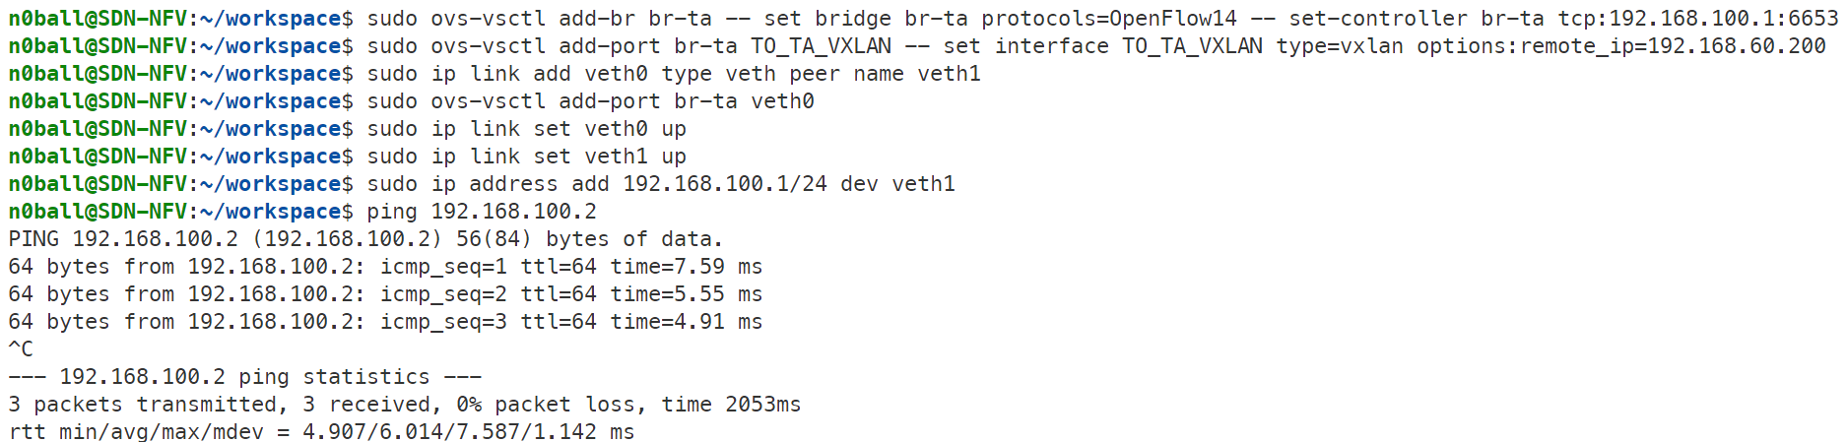
OVS and VXLAN (cont.)
Create a ovs switch named br-ta
Set ovs protocol
Set ovs controller
Set VXLAN connected to IP
Create a VXLAN port name TO_TA_VXLAN on ovs swtich br-ta

Slide 50
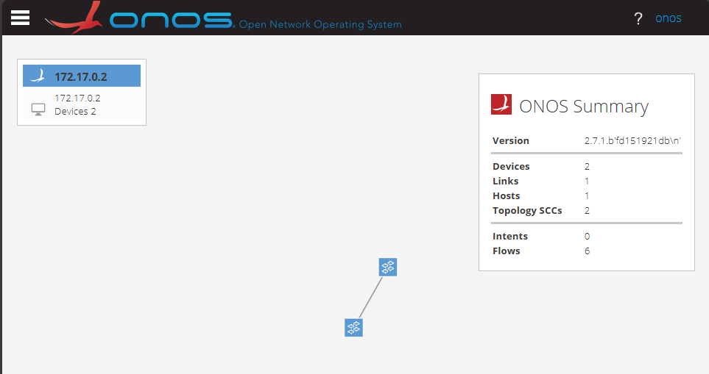
OVS and VXLAN (cont.)
You can use docker to create an onos controller
If you have finish lest step, you shall see two switches connected

Slide 51
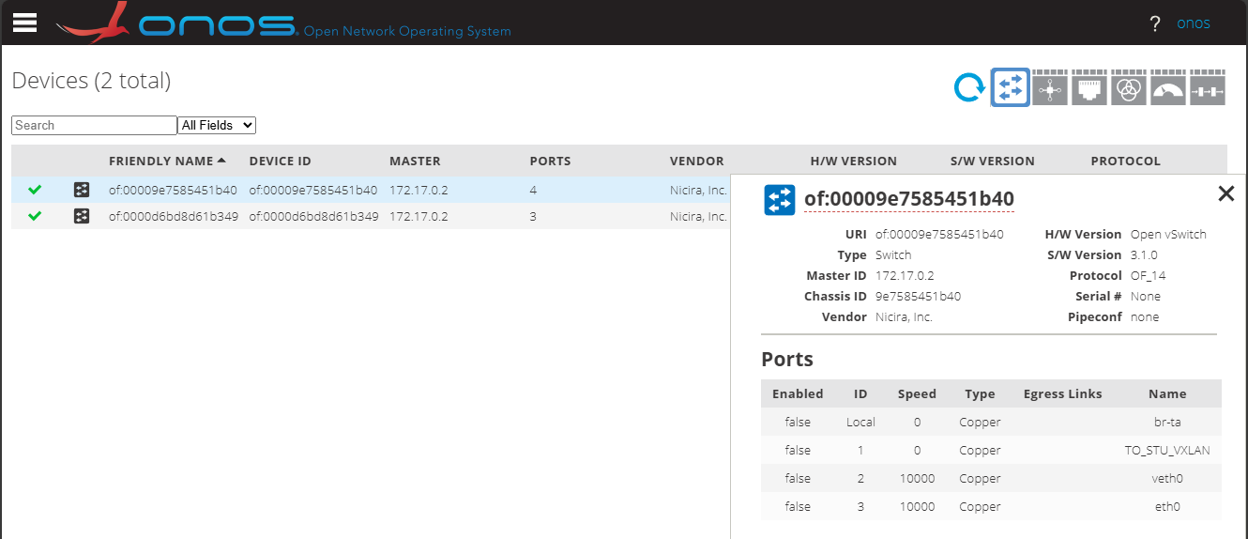
OVS and VXLAN (cont.)
You can see ports on the onos GUI that TA have created for you.
VLAN Port
A Veth for dummy NIC
Connect to AS65000
192.168.100.1/24
192.168.100.2/24
Dummy NIC
Veth
Veth
OVS
VXLAN
VXLAN
OVS
Veth
Veth
Dummy NIC
eth0
Connect to AS65000

Slide 52
Topology Template
192.168.63.1/24
192.168.70.xx/24
172.16.xx.69/24
192.168.100.3/24
fd63::1/64
fd70::xx/64
2a0b:4e07:c4:xx::69/64
AS65xx0
172.17.xx.1/24
2a0b:4e07:c4:1xx::1/64
Also FRRouting
192.168.100.1/24
1Gbps Rate Limit
FRRouting
ONOS
AS65xx1
Host 2
OVS1
TA
172.17.xx.2/24
2a0b:4e07:c4:1xx::2/64
192.168.70.253/24
fd70::fe/64
192.168.63.2/24
fd63::2/64
192.168.61.xx/24
OVS3
VXLAN
AS65000
Host 1
OVS2
172.16.xx.2/24
2a0b:4e07:c4:xx::2/64
192.168.60.xx/24
VXLAN

Slide 53
Sample Topology (x=3)
192.168.63.1/24
192.168.70.3/24
172.16.3.69/24
192.168.100.3/24
fd63::1/64
fd70::3/64
2a0b:4e07:c4:3::69/64
AS65030
172.17.3.1/24
2a0b:4e07:c4:103::1/64
192.168.100.1/24
1Gbps Rate Limit
FRRouting
ONOS
AS65031
Host 2
OVS1
TA
172.17.3.2/24
2a0b:4e07:c4:103::2/64
192.168.70.253/24
fd70::fe/64
192.168.63.2/24
fd63::2/64
192.168.61.3/24
OVS3
VXLAN
AS65000
Host 1
OVS2
172.16.3.2/24
2a0b:4e07:c4:3::2/64
192.168.60.3/24
VXLAN

Slide 54
Sample Topology (x=25)
To avoid misconfiguration, don’t use a-f as IP in your settings.
Use 25, instead
AS65250
192.168.63.1/24
192.168.70.25/24
172.16.25.69/24
192.168.100.3/24
fd63::1/64
fd70::25/64
2a0b:4e07:c4:25::69/64
172.17.25.1/24
2a0b:4e07:c4:125::1/64
1Gbps Rate Limit
FRRouting
ONOS
192.168.100.1/24
AS65251
Host 2
OVS1
TA
172.17.25.2/24
2a0b:4e07:c4:125::2/64
192.168.70.253/24
fd70::fe/64
192.168.63.2/24
fd63::2/64
192.168.61.25/24
OVS3
VXLAN
AS65000
Host 1
OVS2
172.16.25.2/24
2a0b:4e07:c4:25::2/64
192.168.60.25/24

Slide 55
Review of Labs
Lab2
ONOS API
Flow rules
Lab3
Mac learning
Proxy ARP
Lab4
Intent
Meter Table
Lab5 Network Function Virtualization
Simulate Autonomous Systems (AS)

Slide 56
vRouter TODO List
Create a VXLAN tunnel between your SDN network and TA’s server.
ONOS can control OVS.
Adding IPV6 capability.
Intra domain packet handling.
Make sure everything works fine within intra domain traffic.
Virtual Gateway function.
Edge routers can ping each other
Since FRRouting is not directly connect to external router.
FRRouting can push FIB to ONOS controller.
(Connection between 192.168.100.1 and 192.168.100.3)
Deal with inter-domain traffics, i.e. ASx’s hosts can ping ASy’s hosts.
Deal with transit traffics, i.e. ASx’s hosts can ping from outside the world.

Slide 57
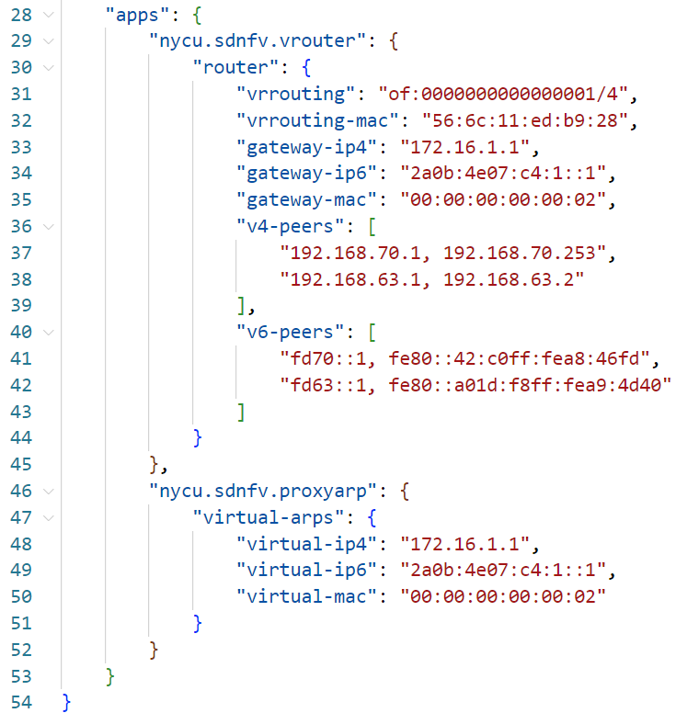
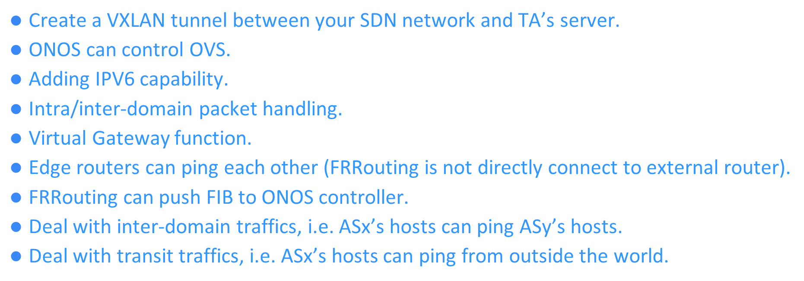
APP Configs
Recommended configs
{

Slide 58
SDN AS Requirements
For service customers (AS65xx0 SDN Network, host 1)
Able to ping FRRouting’s IP (172.16.xx.69/24).
Able to ping student y’s FRRouting’s IP (172.16.yy.69/24).
Use https://tools.keycdn.com/ipv6-ping to see ICMP replies.
For transit ISP (AS65xx1, host 2)
Able to ping host 1 IP (172.16.xx.2/24).
Able to ping student y’s FRRouting’s IP (172.16.yy.69/24).
Able to ping student y’s host 2’s IP (172.17.yy.2/24).
Use https://tools.keycdn.com/ipv6-ping to see ICMP replies.

Slide 59
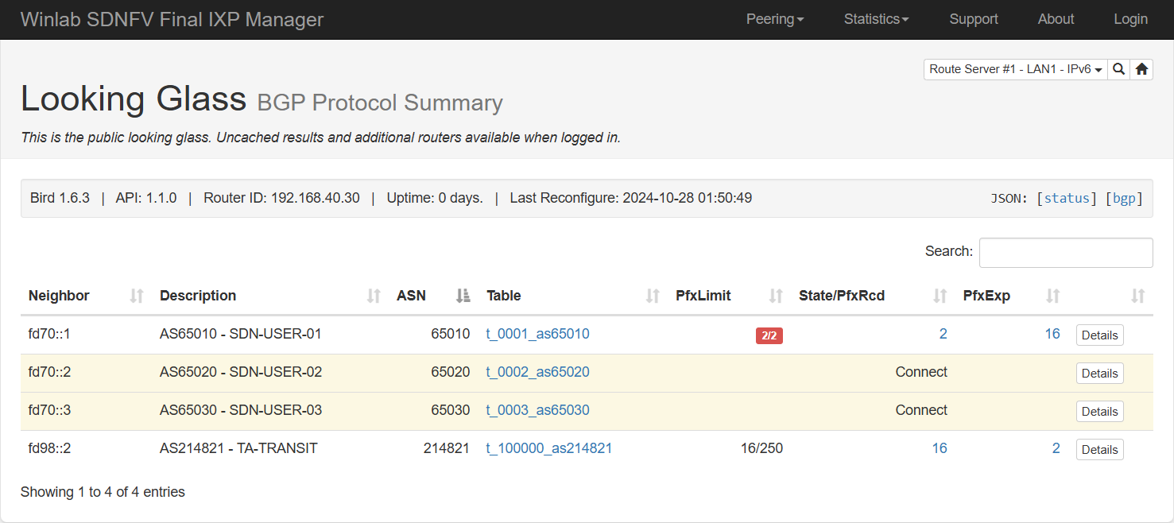
SDN Requirements
You can see what you have announced via IXP Manager
http://140.113.60.171:8880/lg
Choose IPv6 or IPv4
Your ASN
Your x
Click to see what you have announced

Slide 60
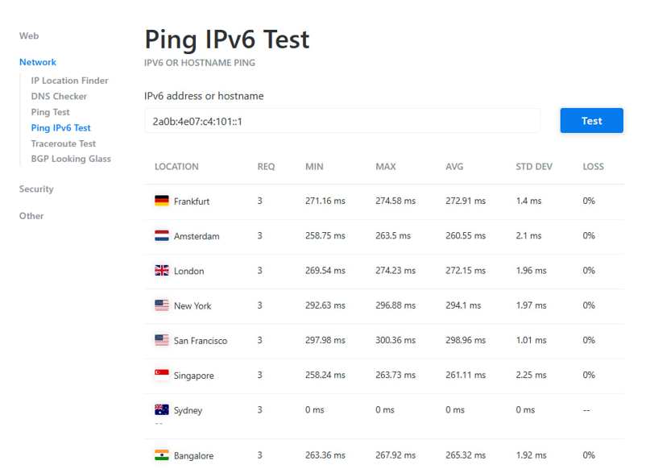
SDN Requirements
You can see that you have connected to the outside world
https://tools.keycdn.com/ipv6-ping

Slide 61
OUTLINE
Review of Labs
Virtual Router Explained
Virtual Router Specification
ONOS App and Services in Use
In Used App Configurations
Virtual Router Workflow
Supplement
Scoring Criteria
Reference

Slide 62
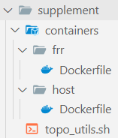
Helper Scripts
There is a utils_topo.sh that might help you to create your topologies.
Use brctl for building linux network bridges
Use ovs-vsctl for building ovs bridges
Hints
Remember to use your old project codes
ONOS might have bugs due to it has not been updated for 2 years
Use wireshark to make sure that the packet is exactly what you expected
Print debug is your best friend
Read the docs
You can turn reactive forward to test your topologies

Slide 63
TA Contacts
If you have any problem
Mail to me
Register demo time for help
Final Project
Team Register (should be done before 12/5, update at everyday noon)
https://docs.google.com/spreadsheets/d/18jBtdl7BgK_GIqJtgEI210icpPq_Et1tVk8eLnFe6Kk/edit?usp=sharing
Demo Register https://calendar.google.com/calendar/u/0/appointments/AcZssZ2sbtt-446xWK_xPxxIv22bY-FV947i-odtBV4=
Deadline: 12/31

Slide 64
OUTLINE
Review of Labs
Virtual Router Explained
Virtual Router Specification
ONOS App and Services in Use
In Used App Configurations
Virtual Router Workflow
Supplement
Scoring Criteria
Reference

Slide 65
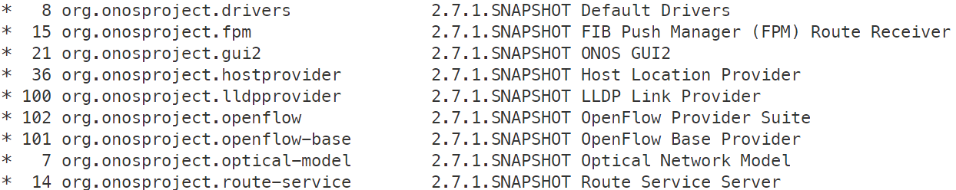
Deployment Requirements
DO NOT TRY TO ATTACK EITHER OTHER STUDENTS OR TA SERVERS
You are required to create a Makefile so that you are able to
Clear the entire project via make clean command
Deploy the project via make deploy command
Only openflow (and route service) related apps can be use
If not, you will be scored 0

Slide 66
Scores
Intra-domain traffic (from both AS)
IPv4 (6 points)
IPv6 (4 points)
Inter-domain traffic (from both AS)
IPv4 (18 points)
IPv6 (12 points)
Transit traffic
IPv4 (18 points)
IPv6 (12 points)
Routes shown in IXP Manager
IPv4 (12 points)
IPv6 (8 points)
Able to communicate with the outside world (10 points)

Slide 67
OUTLINE
Review of Labs
Virtual Router Explained
Virtual Router Specification
ONOS App and Services in Use
In Used App Configurations
Virtual Router Workflow
Supplement
Scoring Criteria
Reference

Slide 68
Reference
RouteService (https://javadoc.io/doc/org.onosproject/onos-cli/1.8.1/org/onosproject/incubator/net/routing/package-summary.html)
ONOS Java API (2.7.0) (https://api.onosproject.org/2.7.0/apidocs/index.html)
ovs-vsctl(8) - Linux manual page (https://man7.org/linux/man-pages/man8/ovs-vsctl.8.html)
ip(8) - Linux man page (https://linux.die.net/man/8/ip)

